Slide 1

How to read a paper and incorporate it in our clinical practice ?
Dr Santam Chakraborty
Senior Consultant, Radiation Oncology

Slide 2

What is evidence based medicine ?
Evidence based medicine is the conscientious, explicit, and judicious use of current best evidence in making decisions about the care of individual patients
The practice of evidence based medicine means integrating individual clinical expertise with the best available external clinical evidence from systematic research.
"Half of what you learn in medical school is dead wrong."

Slide 3
Why most published research may be false

Slide 4
Why most published research may be false

Slide 5
Why most published research may be false
Number of true positive = 80
Number of false positive = 45
Number of true negative = 20
Total true positive = 55%
Visualization idea from : Is most published research false - Veritasium

Slide 6
How to read a paper

Slide 7
Critical Appraisal - How To
Systematic evaluation of scientific papers to answer the following question for each paper:
A clearly focussed question ?
Use valid methods ?
Are valid results important ?
Are valid and important results applicable to your patient population (external validity)
Many tools are available - 2004 systematic review identified 121 published tools (Katrak et al, BMC Medical Research Methodology, 2004)

Slide 8
Key elements of the research question
Population
Intervention
Comparison
Outcome(s)
Describe the population of interest.
Specific description of the main intervention.
Specific description of main comparator intervention (if applicable)
What can be accomplished ?
In patients with radiologically node negative cervical cancer
Would sentinel lymph node biopsy
As compared to standard pelvic dissection
Lead to lower morbidity?

Slide 9
Is the article worth reading ?
Study type | Characteristics
Therapy | Was the assignment to intervention randomized Were all patients who entered the trial accounted for and analyzed
Diagnosis | Was there an independant blind comparison with reference standard Was the sample representative of the patient population in whom the diagnostic test will be applied in practice
Harm | Were there clearly defined comparator groups Were exposures and outcomes measured in the same manner
Prognosis | Was there a representative patient sample Was the follow up long and complete

Slide 10
Assessing an RCT
Validity:
  Was the assignment to the interventions truly random
  Were all patients who entered the trial accounted for:
    Was the follow up complete
    Were patients analyzed in the groups they were randomized (ITT)
  Were the patients, clinicians and study personnel blinded to the treatment allocation.
  Were the groups similar at the start of the treatment.
  Aside from experimental therapy were the groups treated equally.
Results:
  How large was the treatment effect
  How precise was the estimate of the treatment effect
Notes:
Random assignment is the best method by which we can estimate the effect of a given intervention on the outcome of interest. This because, the process of randomization removes the random variability and unconscious bias we all have when patients are offered a treatment and when treatment is delivered. However just random allocation is not random. Few things need to be considered carefully when determining if the assignment was truly random. First weather the randomization sequence was generated by a random number generator (consecutive numbers or alternate days are not methods of random allocation). Second if the method of sequence generation is valid and third if the allocation is concealed - i.e. you cannot tell which arm the next patient will fall into. If there is absence of allocation concealment then the random allocation process is vitiated.
The second important aspect to evaluate is the completeness of patient follow up. In case there is a doubt as a simple thought experiment see if you assume that all experimental arms patients lost to follow up had an event and all control arm patients lost to follow up were without events would the results change. If so then the results obtained from the study are possibly unreliable due to excessive loss to followup. Similarly ITT is important as it preserves the balance of the prognostic groups which randomization ensures - thus drop outs due to unknown / known factors do not contaminate the results - the inferred treatment effect estimate is conservative.
Blinding of the trial is a very important means to ensure the validity of the measured outcomes. Unblinded trials have a significant risk that the outcomes will be influenced by the knowledge of the intervention arm - and this can be quite insidious.
Ensuring that the trial participants receive the same treatment aside from the experimental treatment can be quite challenging. For example in a study comparing a highly emetogenic chemotherapy regimen versus a immunotherapy regimen where emetogenicity is low, ensuring that the participants receive same kind of antiemetic prophylaxis can be challenging. Such interventions are called co-interventions and are difficult to control for unless blinded assessments are done. At the very least all such co-interventions should be explicitly spelled out and outlined in the protocol. In the same manner the schedule of assessments and follow up for the patients should be same between the two groups.

Slide 11
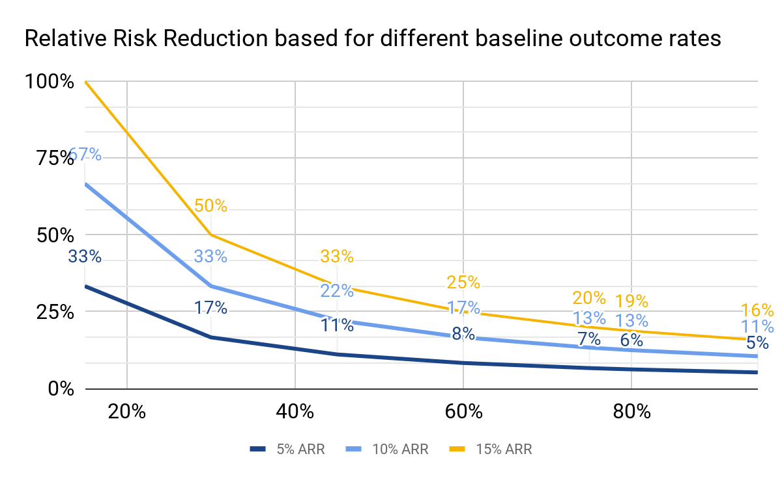
Treatment effects
The change in risk of an outcome following an intervention is usually an endpoint of interest.
The change in risk is expressed using some form of risk ratio:
  Odds ratio: For binary outcomes from cohort / RCT
  Hazard ratio: For time to event outcomes from cohort / RCT
  Relative risk : For binary outcomes from case control studies
Risk reduction can be expressed as:
  Absolute risk reduction: A - B
  Relative risk: B/A
  Relative risk reduction: 1- (B/A)
Clinically absolute risk reductions are more meaningful than relative risk reduction
Plot showing the change in relative risk reduction for different control arm outcome rates. 3 different ARR scenarios are considered (5%, 10% and 15%).
Note as the baseline control rate reduces (event rate reduces) for a much higher relative risk reduction occurs for the same absolute risk reduction
Notes:
The concept of relative and absolute risk reduction should be very clear in mind. Most of the time for clinical purposes, we rely on absolute risks reduction as that correctly tells how many patients will benefit from the intervention. .

Slide 12
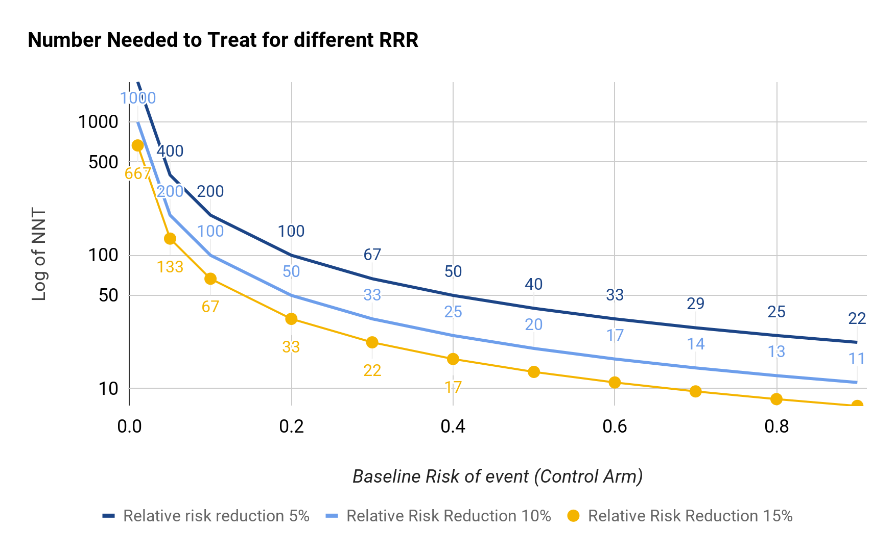
NNT and NNH
NNT = Number needed to treat
NNH = Number needed to harm
Both are derived from the absolute risk reduction
It is the reciprocal of absolute risk reduction (or increase in case of NNH).
Provides a quantifiable number for relative risk reduction which can be used to aid decision making.
Rarer the event the greater the NNT for the same degree of relative risk.

Slide 13
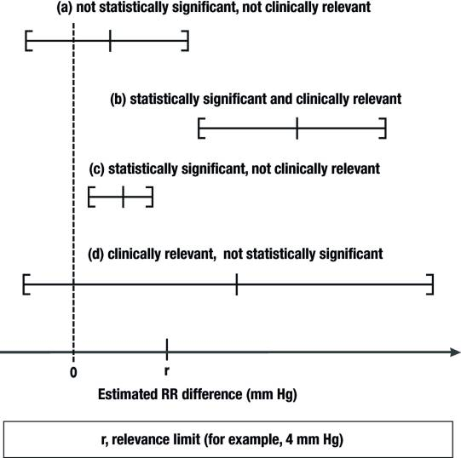
Precision of estimate
Precision of the estimate needs Confidence intervals
Confidence interval ≠ statistical significance
Typically indicates the range in which the relative risk reduction will be observed
Larger trials = narrow CIs
The bounds of the CI indicate if the effect is truly positive (or in the direction intended).
CI also can help you judge “clinical significance”
  In positive trials take a look at the lower bound and decide if the lower bound of the estimate is still clinically relevant
  In negative trials take a look at the upper bound and see if it is clinically relevant - the trial has failed to “exclude” a potentially important treatment effect
du Prel J-B, Hommel G, Röhrig B, Blettner M. Confidence interval or p-value?: part 4 of a series on evaluation of scientific publications. Dtsch Arztebl Int. 2009 May;106(19):335–9.

Slide 14

What about p value
Observed significance level for the test hypothesis
In essence tests if the data conforms to an assumed statistical model
A test of model assumptions + null hypothesis
P-value being small ≠ null hypothesis is FALSE
P-value does not tell us anything about effect size.
P-value does not tell us if the effect is important
Cartoon from: https://thedailytexan.com/2016/04/08/american-statistical-association-releases-statement-questioning-p-values

Slide 15
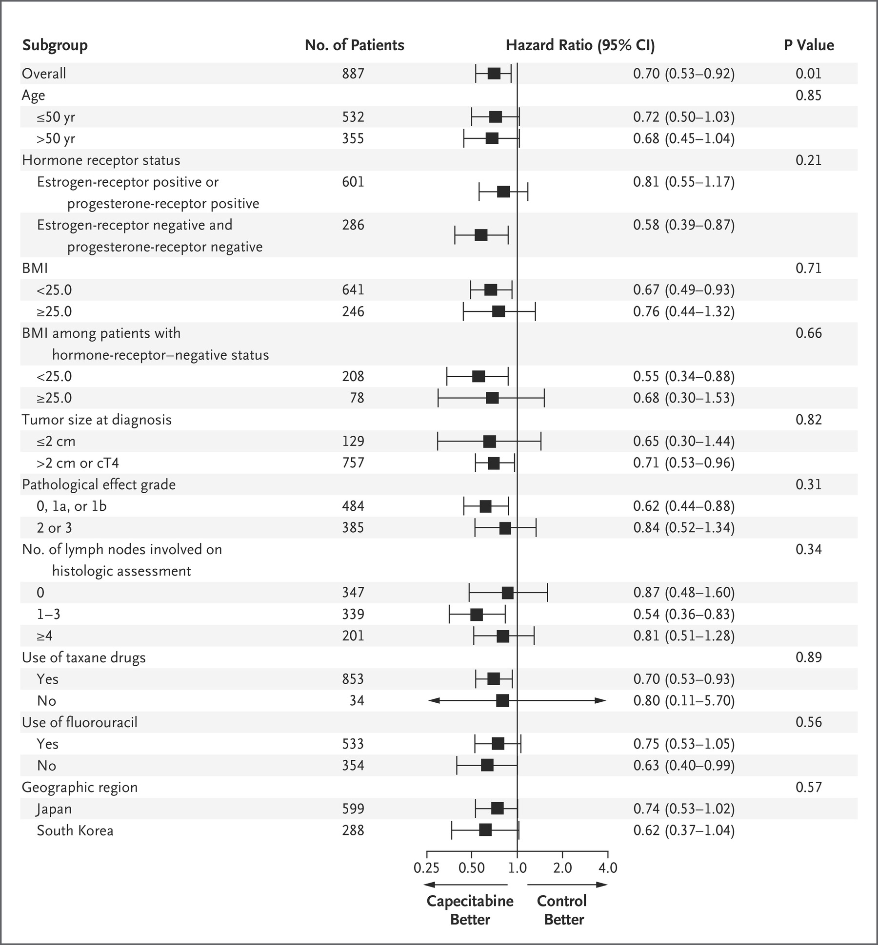
Assessing Subgroup Analyses
Groups of patients may respond differently to the intervention - subgroup analyses undertaken to find this effect
Even in RCTs chance influences results in subgroup analyses in a big way.
Subgroup claims are commonly misleading and not credible.
Masuda N, Lee S-J, Ohtani S, Im Y-H, Lee E-S, Yokota I, et al. Adjuvant Capecitabine for Breast Cancer after Preoperative Chemotherapy. N Engl J Med. 2017 Jun 1;376(22):2147–59.
Notes:
Chance is a very important thing and is very much underappreciated by clinicians who have a deterministic thought process. In the figure we can see that the 95% CI of the relative risk does not cross 1. Does this mean we can conclude that Group 2 derives benefit from the intervention while Group 1 does not ? No since the 95% CI overlap there is a good chance that this is a chance observation. The point estimates are nearly similar. The null hypothesis when we compare the treatment effects in two group is that treatment effects are same in both groups. Hence the correct test to perform is an interaction test which given the similarity of point estimates and overlapping 95% CI will not be significant. In other words you CANNOT reject the null hypothesis that there is no treatment effect. Similarly a failure to show a difference does not mean that a difference does not exist - this may be a simple effect of the sample size. If the statistical test for interaction suggests that an subgroup effect is significant this does not mean that it is a true effect but that this effect should be taken seriously. Astute clinicians would understand that this implies that another trial is needed.

Slide 16
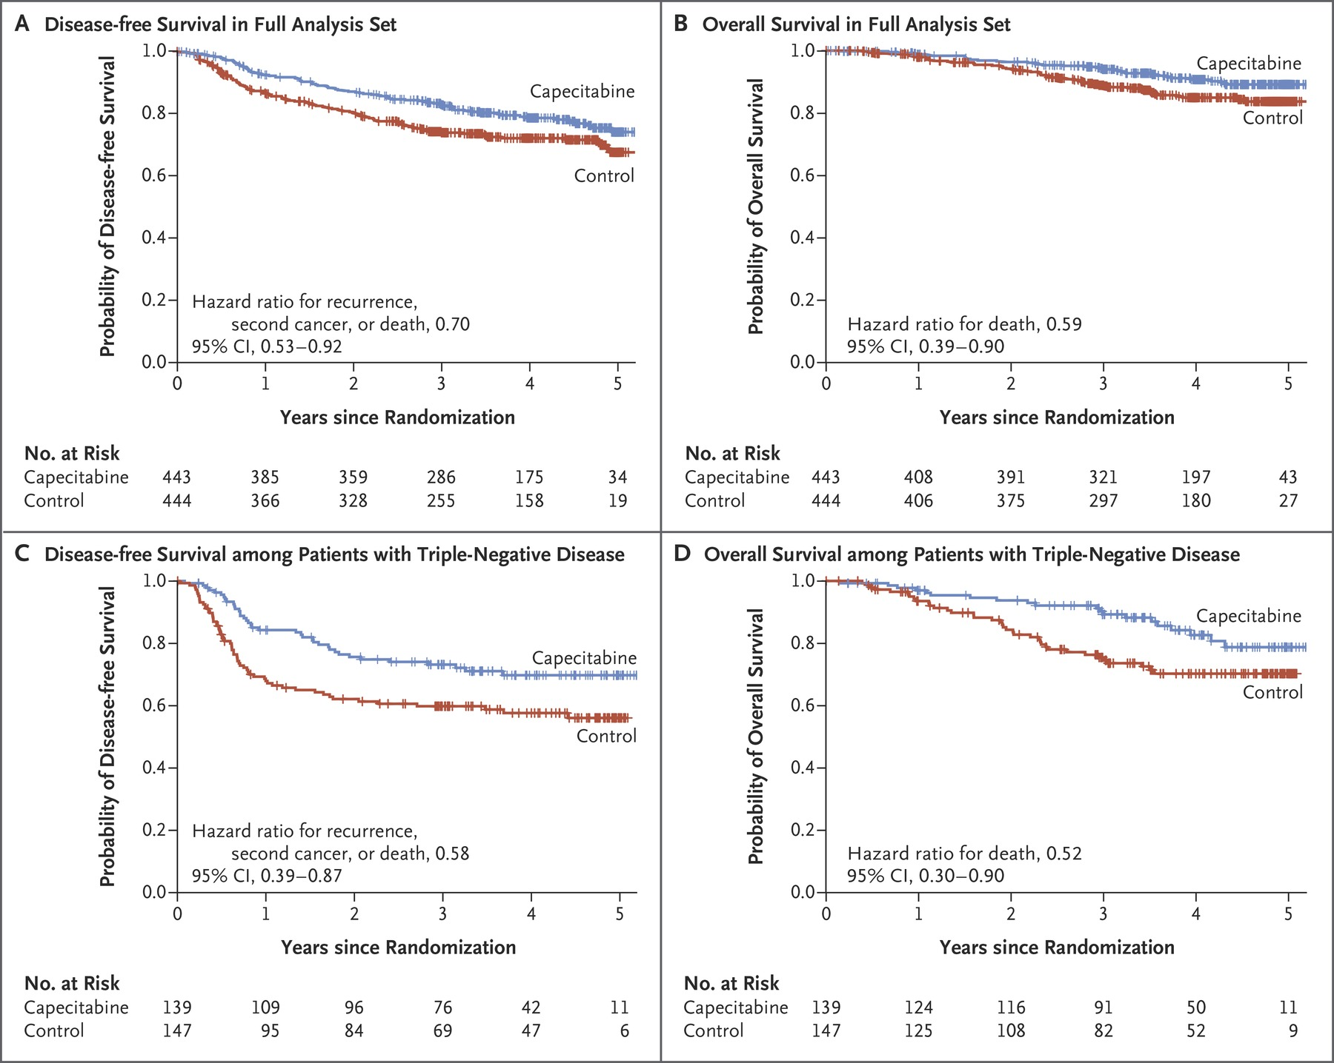
Example: CREATE-X Trial
Masuda N, Lee S-J, Ohtani S, Im Y-H, Lee E-S, Yokota I, et al. Adjuvant Capecitabine for Breast Cancer after Preoperative Chemotherapy. N Engl J Med. 2017 Jun 1;376(22):2147–59.
Notes:
The authors concluded that capecitabine showed effectiveness as an adjuvant option in patients with HER2-negative breast cancer who had residual invasive disease after standard neoadjuvant chemotherapy. Our trial showed that adjuvant capecitabine therapy prolonged disease-free survival and overall survival among patients with breast cancer who had a poor prognosis, including those with triple-negative disease, and was associated with expected toxic effects.

Slide 17
Is the subgroup effect important ?
01
Is the subgroup variable measured before / after randomization
Was the hypothesis specified a priori with its direction
Was it one of a small number of hypothesized effects tested
Subgroup effect study design
02
Does interaction test suggest a low likelihood that chance explains the subgroup effect
Is the significant subgroup effect independent
Subgroup effect analysis
03
Is the size of the subgroup effect large
Is the interaction consistent across studies
Is the interaction consistent across closely related outcomes
Is there a biological rationale for the subgroup effect
Subgroup effect context
Notes:
As subgroup analysis and interpretation is such a major source of error I am recapitulating the main points to be ascertained when subgroup effects are to be considered for therapeutic decision making. All of these criteria are to be backed by sound judgement and a healthy amount of skepticism.

Slide 18
Assessing Generalizability
Trial Setting
Patient Selection
Patient Characteristics
Trial Protocol
Outcomes & FU
Adverse effects
Country
Pre-randomisation diagnosis
Baseline clinical characteristics
Trial intervention
Surrogate & composite outcomes
Completeness of reporting
Healthcare system
Eligibility Criteria
Racial group
Timing of treatment
Complex scales
Rate of treatment discontinuation
Centers
Randomized : Nonrandomized
Stage & severity of disease
Standard control
Outcome measurement method
Exclusion based on complication risk
Clinicians
Declined randomisation
Comorbidity
Co-interventions
PROMs
Selection of centers / clinicians
Care Level
Run-in period
Absolute risk of poor outcome
Advances in care
Follow up freq and adequacy
Intensity of safety procedures
Rothwell PM. External validity of randomised controlled trials: “To whom do the results of this trial apply?” Lancet. 2005 Jan 1;365(9453):82–93.
Notes:
The trial setting especially the country and healthcare setting play an important role. For example similar healthcare settings may have widely different referral practices which may affect outcome in cancers where therapy delays ar known to be associated with poorer outcomes. Trials done with expert centers and clinicians may also be difficult to generalise to the community setting and similarly trials conducted in tertiary level centers may be difficult to implement in resource constrained primary settings.
The pre-randomization diagnostic workup done as well as referral bias may reduce representativeness of the patient population. Sick person syndrome refers to the bias that occurs when a tertiary hospital population is used as it may have the sickest patient population. Racial groups may have unknown / known differences in how they respond to therapy as well as external socio-economic factors that limit generalisability. Comorbidity levels are poorly reported but can be very important for decision making when treating real world patients. The absolute risk of poor outcome due to stage and severity of the disease may be very different and this has particular implications when considering non-inferiority trials.
The trial protocol may limit generalisability if the interventions, control and co-interventions are performed in non-standard manner. For example, a highly complex surgical procedure may have improved outcomes only in the hands of a experienced few surgeons. Advances in care may make the trial results non-generalisable - for example after a new drug may make the old standard redundant.
Surrogate outcomes are outcomes where an endpoint is thought to represent another e.g. response rate as a surrogate for survival make it difficult to get an idea regarding the benefit that the patient may accrue especially as surrogate endpoints are not meaningful to the patient. Further the assumed correlation between the outcomes may be difficult to prove. Complex scales used to measure outcome hamper real world implementation and PROMs are often difficult to generalise in different socio-cultural contexts. Finally the follow up needs to be adequate and complete to ensure findings in the short term are applicable for the longer term too.
Adverse effects are a very important part of the decision making process as they allow you to give a measure of the harms. Exclusion based on risk of complication as well as observed complications in the run-in period limit generalisability of the study.

Slide 19
Generalizability of results
Do not rigidly apply inclusion and exclusion criteria
Ask the question - is there a strong reason to suspect that the results WILL NOT be applicable
Do not generalise subgroup analysis results with strong justification
Check if the outcomes considered were clinical important for the patient
  Surrogate endpoints
  Composite endpoints
See if you can calculate the NNT and NNH in your patient.

Slide 20
How to implement it in your practice

Slide 21
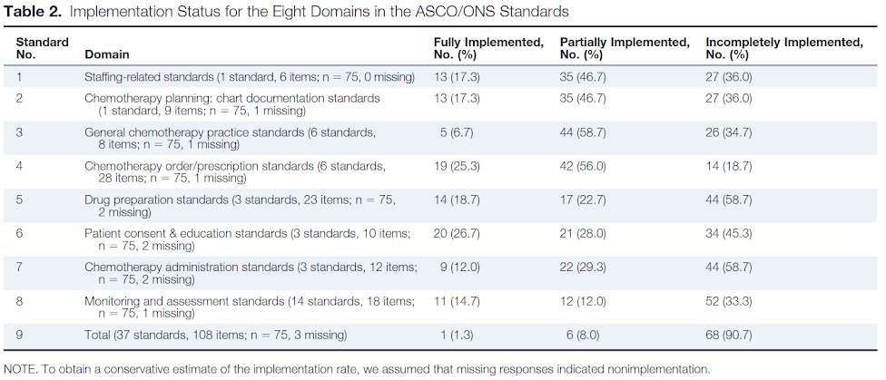
Implementation .. is it a rocket science ?
Patil VM, Chakraborty S, Bhattacharjee A, Dessai S. Survey of the State of Implementation of the American Society of Clinical Oncology/Oncology Nursing Society Safety Standards for Chemotherapy Administration in India. J Oncol Pract. 2015 Sep;11(5):365–9.
Notes:
A survey of 75 institutes of whom 64 were aware of the ASCO ONS standards for safe chemotherapy administration. Complete implementation of all standards was there in a single institute. The standards were published in 2013 and survey was conducted full 2 years after this.

Slide 22
Barriers in Implementing EBM
System Level
Staff Level
Intervention Level
Environment :
  Staff time
  Workload
  Workflow
  Space available
  Staff turnover
Culture
  Attitude to change
  Commitment
  Flexibility
  “Champions”
Communication process
External requirements
  Reporting standard
  Guidelines
Commitment & attitude
  Perceived need
  Ownership
  Perceived safety
  Perceived efficiency
  Belief in change
Understanding & awareness
Role Identity
  Flexibility
  Responsibility
Skills, confidence & ability
Ease of integration
  Complexity
  Cost
  Flexibility
  Acceptability
Face validity
  Evidence
Safety
  Patient / Staff
  Ethical concerns
  Medicolegal issues
Support available
  Education
  Feedback
  User involvement
Geerligs L, Rankin NM, Shepherd HL, Butow P. Hospital-based interventions: a systematic review of staff-reported barriers and facilitators to implementation processes. Implement Sci. 2018 Feb 23;13(1):36.

Slide 23
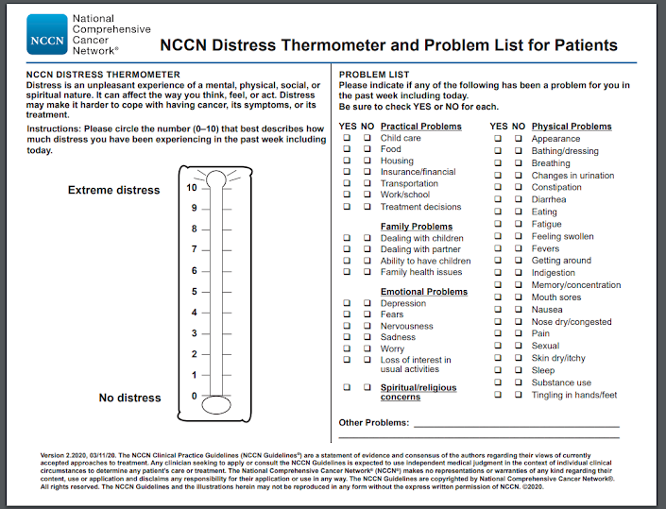
Are you ready to implement ?
NCCN recommends routine distress assessment - the DT is a simple screening tool
Single day pilot testing done in a tertiary cancer center
All patients attending OPD would be offered DT screening.
All elements translated for each patient individually by physicians and nursing assistants / nurses.
Nearly 15% of the population could not be screening despite efforts from 9 authors and a corresponding number of nurses and nursing assistants of the total 170 patients who visited OPD !!
Dessai SB, Chakraborty S, Sajeev Kumar PB, Babu S, Muttath G, Nair C, et al. Pilot study of single-day distress screening with the NCCN distress thermometer to evaluate the feasibility of routine distress screening in tertiary cancer center in rural India. Psychooncology [Internet]. 2014 Dec 22;

Slide 24
Approach to Implementation of EBM
System Level
Staff Level
Intervention Level
Macro-level
Interview stakeholders
Dedicated measures:
  Organizational readiness for implementing change (ORIC)
  Alberta context tool
Understand system level challenges
Micro-level
Understand staff engagement
Explore beliefs regarding intervention
Targeted education and training
Integration of feedback
Share experience with others
Adaptability of intervention is a key requirement
Emphasize pilot testing for feasibility and acceptability
Geerligs L, Rankin NM, Shepherd HL, Butow P. Hospital-based interventions: a systematic review of staff-reported barriers and facilitators to implementation processes. Implement Sci. 2018 Feb 23;13(1):36.

Slide 25
JBI Method
1
Identify the practice area
Identify the issue which is relevant to key stakeholder groups
Garner support of this stakeholder group
Build a consensus within the stakeholder group
Establish a formal working group
Prepare a plan:
  Clear goal and objectives
  Obtain support from executive
  Communication strategy
2
Engage the change agents
3
Assess context and readiness to change
4
Review practice against evidence based criteria
5
Implement changes to practice using GRiP
6
Reassess practice using a follow up audit
7
Consider sustainability of the project

Slide 26
JBI Method
1
Identify the practice area
Change agents are leaders, facilitators or champions who can bring about change
Setup a project manager for large scale projects
Facilitators ensure that they motivate, guide and communicate following the strategy define earlier
Face to face communication generally results in better facilitation
2
Engage the change agents
3
Assess context and readiness to change
4
Review practice against evidence based criteria
5
Implement changes to practice using GRiP
6
Reassess practice using a follow up audit
7
Consider sustainability of the project

Slide 27
JBI Method
1
Identify the practice area
Understanding the macro-picture i.e. the system / organisation
Analysis required of:
  Commitment to change
  Ability to change
Key aspects that need to be looked into:
  Decision making process
  Staff strength
  Workplace culture
  Communication
  Resource availability - material and time
  KAP
  Relationships between groups
2
Engage the change agents
3
Assess context and readiness to change
4
Review practice against evidence based criteria
5
Implement changes to practice using GRiP
6
Reassess practice using a follow up audit
7
Consider sustainability of the project

Slide 28
JBI Method
1
Identify the practice area
Conduct a clinical audit
Audit defined as a process that seeks to improve outcomes through a systematic review of care against explicit criteria
Audits need to be a process not one-off
Needs to have a clearly defined objective
Two key aspects:
  Sampling strategy
  Data collection process
2
Engage the change agents
3
Assess context and readiness to change
4
Review practice against evidence based criteria
5
Implement changes to practice using GRiP
6
Reassess practice using a follow up audit
7
Consider sustainability of the project

Slide 29
JBI Method
1
Identify the practice area
Getting Research into Practice (GRiP):
  Baseline audit
  Identify barriers and enablers
  Develop strategy for change
Common barriers are:
  Knowledge
  Cultural / Religious
  Psychosocial
  Resource limitations
Common strategies:
  Reminders
  Education e.g meeting/classes
  Financial incentives
2
Engage the change agents
3
Assess context and readiness to change
4
Review practice against evidence based criteria
5
Implement changes to practice using GRiP
6
Reassess practice using a follow up audit
7
Consider sustainability of the project

Slide 30
JBI Method
1
Identify the practice area
Goal to identify compliance with preset evidence based criteria
Audit should be done based on the same criteria so that change from baseline can be demonstrated.
2
Engage the change agents
3
Assess context and readiness to change
4
Review practice against evidence based criteria
5
Implement changes to practice using GRiP
6
Reassess practice using a follow up audit
7
Consider sustainability of the project

Slide 31
JBI Method
1
Identify the practice area
Sustainability refers to capability to sustain and maintain evidence based practice
A team needs to be in place which can conduct regular audits to ensure compliance with standards is achieved
Scaling up of the project is also a part of sustainability
2
Engage the change agents
3
Assess context and readiness to change
4
Review practice against evidence based criteria
5
Implement changes to practice using GRiP
6
Reassess practice using a follow up audit
7
Consider sustainability of the project

Slide 32
Implementation of DIBH for Left breast cancers
Understand the problem
Left sided breast cancers often have high cardiac doses which can be substantially reduced by Deep inspiration breath hold. However DIBH is resource intensive to implement
05
Publication
Published the resource requirements and demonstrated that DIBH was extremely cost effective in Indian settings
01
04
Implementation
After pilot testing showed that DIBH could be implemented in all patients the same was rolled out for all patients
Training
Lead Physicist trained a group of radiographers over a period of time and wrote up a protocol for DIBH in breast cancers.
02
03
Pilot Testing
50 consecutive patients treated with supervision. Time taken for each step noted down as a service development audit.
Chatterjee S, Chakraborty S, Moses A, Nallathambi C, Mahata A, Mandal S, et al. Resource requirements and reduction in cardiac mortality from deep inspiration breath hold (DIBH) radiation therapy for left sided breast cancer patients: A prospective service development analysis. Pract Radiat Oncol [Internet]. 2018 Mar 22; Available from: http://dx.doi.org/10.1016/j.prro.2018.03.007

Slide 33
Cognitive Bias in accepting EBM
A systematic error in the process of our “mental-shortcuts”
Implementation of EBM can be affected by cognitive bias:
  Omission Bias : Tendency to judge actions that lead to harm as worse / less moral than equally harmful non-actions (omissions).
  Commission Bias : Tendency to prefer action over inaction to avoid regret over missed opportunity when a procedure is not performed.
  Status-quo Bias : Preference for the current state due to aversion to loss.
  Availability Bias : Likelihood predictions are based on what can be remembered easily.
  Framing Bias : Our response to a choice depends on how it is presented.
Notes:
Omission bias often result in us not providing aggressive treatment as it may harm a proportion of patients or not prescribing chemopreventive medications as we are biased towards the harm arising out the intervention.
Commission bias on the other had often results in expensive or unneeded testing and interventions. Commision bias is usually less common. Omission bias is more common as we feel that events that have occurred through the natural progression of a disease are more acceptable than those that may be attributed directly to the action of the physician.
Status quo bias often results in reluctance to change the ongoing treatment even when evidence strongly favours a change. The change may be intensification or de-escalation.
Availability bias refers to our tendency to consider events which can be recalled easily to have a higher probability as compared to events which cannot be easily recalled. For example, when you are asked to determine the probability of a mediastinal nodal enlargement to be benign and malignant oncologists will often favour a malignant etiology while non-oncologists often a benign etiology.
Framing bias refers to our tendency to react to choice based on how it is presented. Thus if the article presents a relative risk reduction of more physicians will consider a new drug to be more effective than if presented with absolute risk reduction.

Slide 34
Avoiding our own cognitive bias
Various methods are available for “cognitive de-biasing”
Being aware that a bias exists
Educational tools that have an embedded cognitive trap
Slowing down strategies in workplace :
  Decision aids
  Checklists
  Planned time-outs
  Planning meets
Deliberate real-time reflection over one’s own thinking process - meta-cognition. E.g consider the opposite
Well designed clinical protocols - minimize variance and allow scope of documentation of deviations.

Slide 35
Conclusions
Reading a scientific paper - skill that needs to be acquired
Sound grounding in principles of EBM is necessary
Study design matters
Pay attention to confidence intervals.
Avoid placing too much faith in subgroup analyses
Remember that we all have cognitive biases - “measure twice before cutting”
Develop protocols and checklists
Read .. read .. read & then read some more.

Slide 36
Tools & Resources
Critical Appraisal Skills Programme (CASP) : https://casp-uk.net/casp-tools-checklists/
CEBM Critical Appraisal Tools : https://www.cebm.net/2014/06/critical-appraisal/
Joanna Brigg International Tools : critical-appraisal-tools - Critical Appraisal Tools
Appraisal guidelines for research and evaluation (AGREE) : AGREE Tools
EQUATOR Network for reporting guidelines : The EQUATOR Network | Enhancing the QUAlity and Transparency Of Health Research
Sackett DL, Rosenberg WM, Gray JA, Haynes RB, Richardson WS. Evidence based medicine: what it is and what it isn’t. BMJ. 1996 Jan 13;312(7023):71–2.
Dobler CC, Morrow AS, Kamath CC. Clinicians’ cognitive biases: a potential barrier to implementation of evidence-based clinical practice. BMJ Evid Based Med. 2019 Aug;24(4):137–40.
JAMA Series on User’s guide to medical literature - multipart series
JBI Manual for evidence implementation : How to get evidence into practice
Catalogue of bias : A website list major bias that can occur in medical research and the implications thereof.
List of cognitive bias: The wikipedia page is a good starting point.
50 cognitive and affective biases and medicine

Slide 37
Thank You

Slide 38
Critical appraisal tools
Critical Appraisal Skills Programme (CASP) : https://casp-uk.net/casp-tools-checklists/
CEBM Critical Appraisal Tools : https://www.cebm.net/2014/06/critical-appraisal/
Joanna Brigg International Tools : critical-appraisal-tools - Critical Appraisal Tools
Appraisal guidelines for research and evaluation (AGREE) : AGREE Tools
EQUATOR Network for reporting guidelines : The EQUATOR Network | Enhancing the QUAlity and Transparency Of Health Research
Notes:
EQUATOR - Enhancing the Quality and Transparency of health research

Slide 39
Reading Resources
Sackett DL, Rosenberg WM, Gray JA, Haynes RB, Richardson WS. Evidence based medicine: what it is and what it isn’t. BMJ. 1996 Jan 13;312(7023):71–2.
Dobler CC, Morrow AS, Kamath CC. Clinicians’ cognitive biases: a potential barrier to implementation of evidence-based clinical practice. BMJ Evid Based Med. 2019 Aug;24(4):137–40.
JAMA Series on User’s guide to medical literature - multipart series
JBI Manual for evidence implementation : How to get evidence into practice
Catalogue of bias : A website list major bias that can occur in medical research and the implications thereof.
List of cognitive bias: The wikipedia page is a good starting point.
50 cognitive and affective biases and medicine

Slide 40
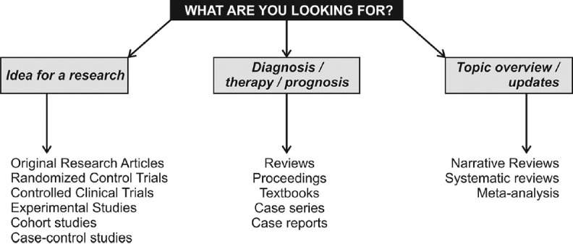
What to read
Why read ?
  To further one’s knowledge:
    Disease pathophysiology and epidemiology
    Prognosis and natural history
    Treatment options
  To prepare for one’s own research
  To fulfill an assignment
What to read ?
  Depends on your motivation and reason
  Depends also on the time you have !!

Slide 41

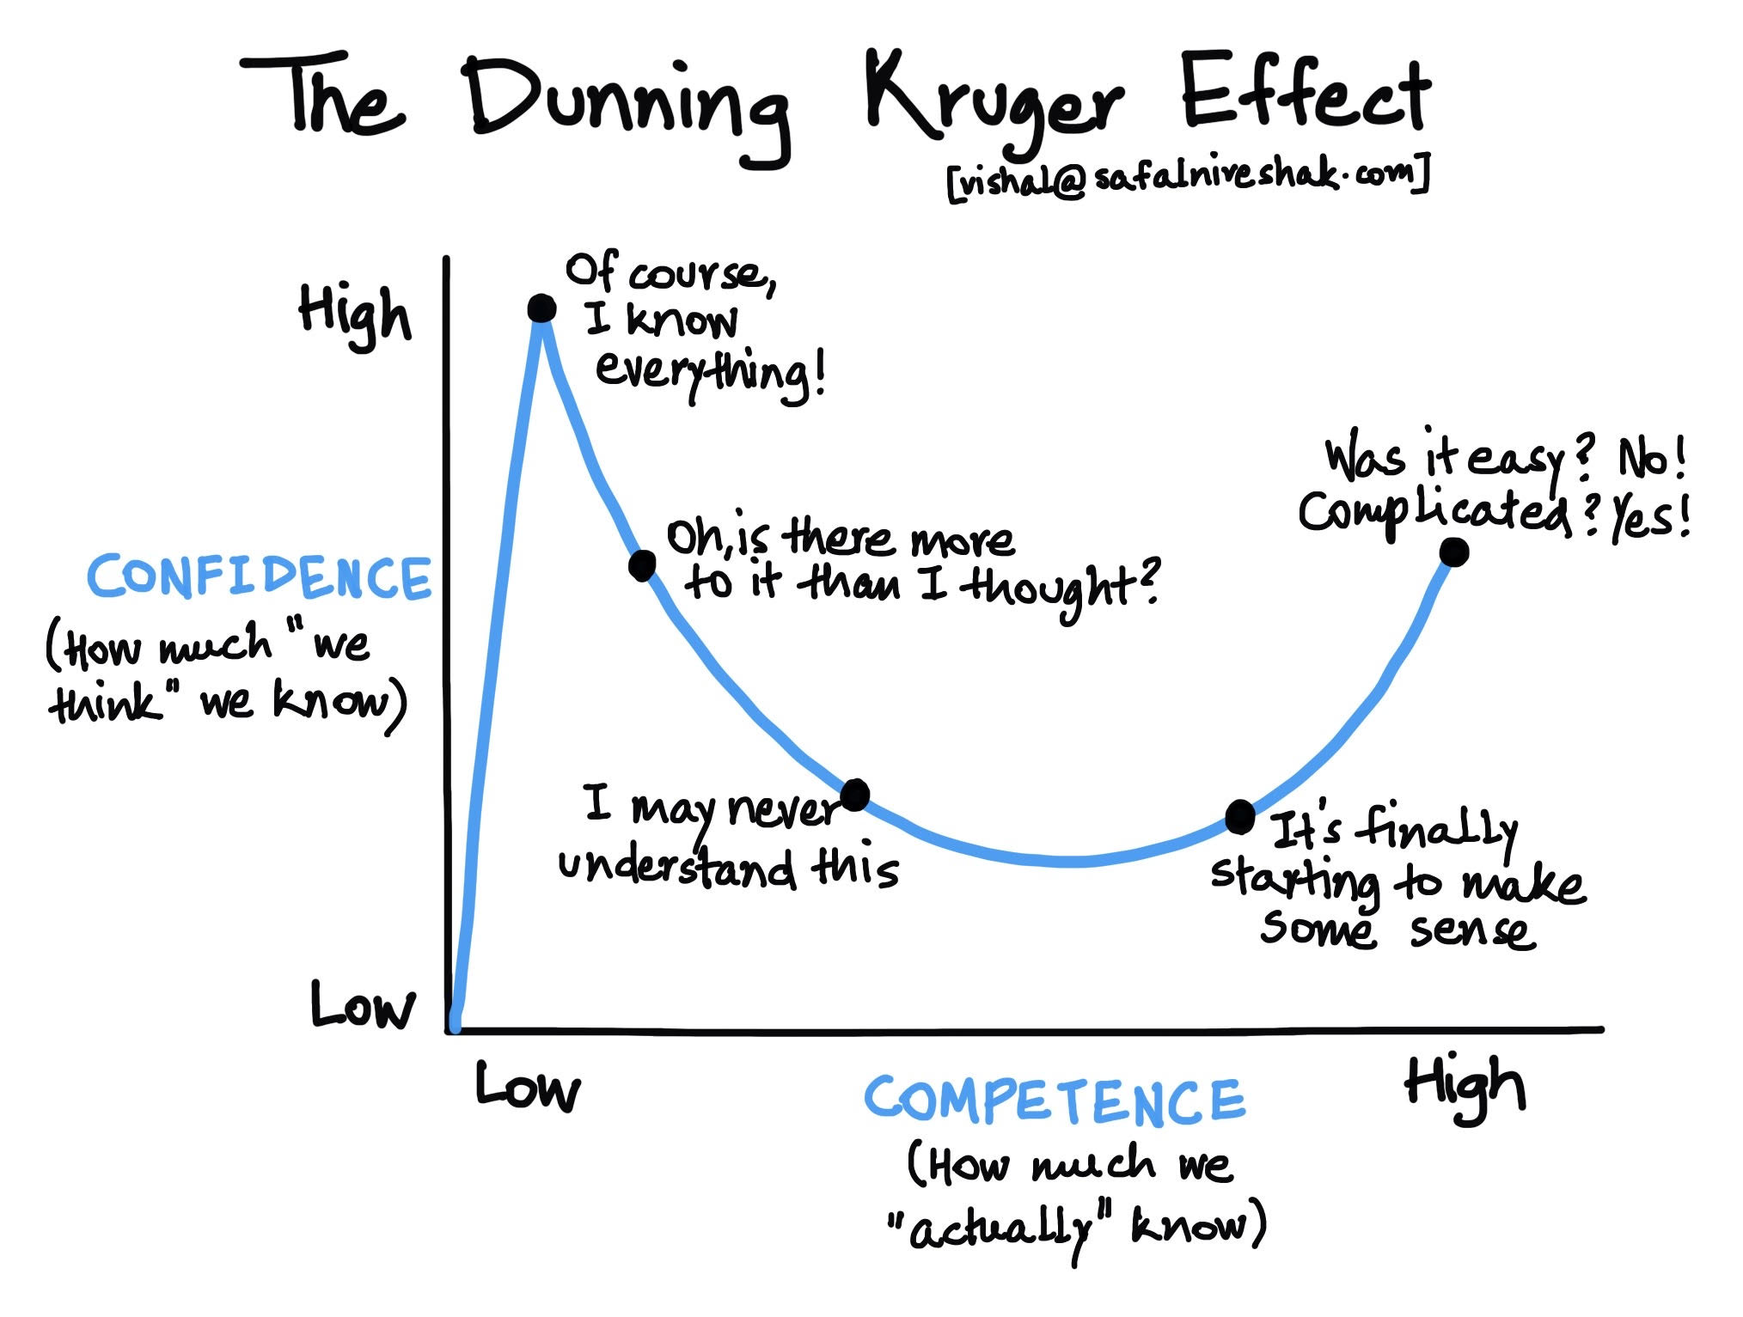
Why you need to know this ?

Slide 42
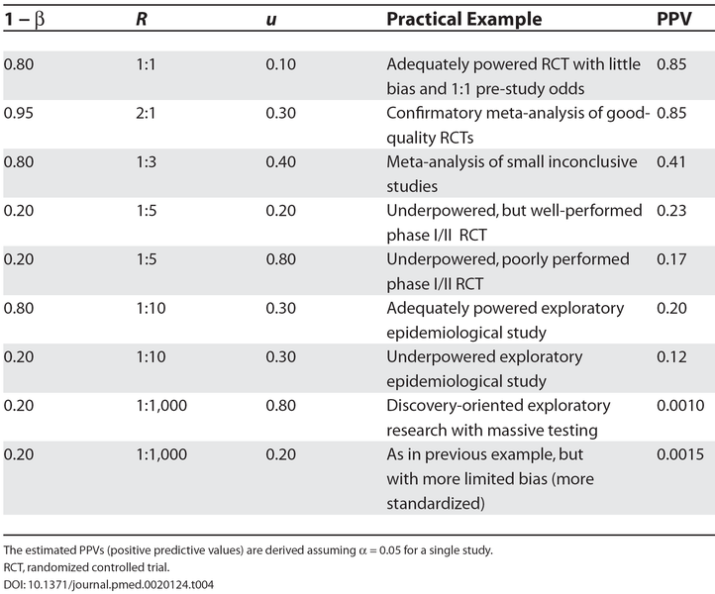
Is published research true ?
Ioannidis JPA. Why most published research findings are false. PLoS Med. 2005 Aug;2(8):e124.

Slide 43
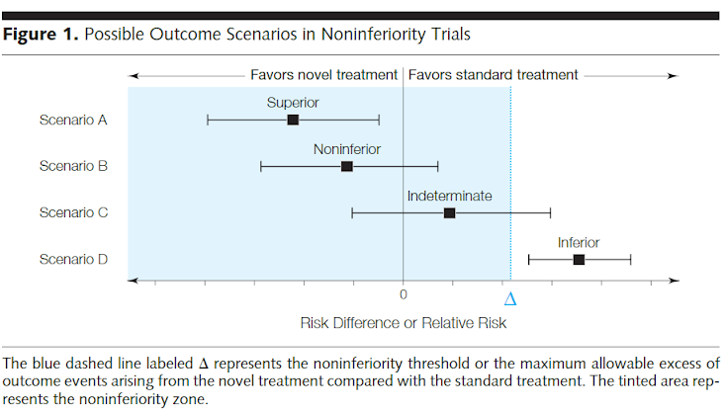
Assessing non-inferiority
Design : Choice of threshold to determine non-inferiority
Validity :
  Was effect of standard treatment preserved.
  Was an per-protocol analysis also done (in addition to ITT).
Mulla SM, Scott IA, Jackevicius CA, You JJ, Guyatt GH. How to use a noninferiority trial: users’ guides to the medical literature. JAMA. 2012 Dec 26;308(24):2605–11.
Notes:
The non-inferiority study should be a prespecified non-inferiority trial. Sometimes superiority trials get reported as non-inferiority trials.
The threshold which determines non-inferiority is critical to understand. The threshold should be determined by what is the largest possible detriment you would accept in outcomes for the benefits provided by the intervention. Too large a non-inferiority boundary runs the risk of being unacceptable in clinical practice. There is guidance available for determining non-inferiority but typically it should be no more than 50% of the benefit of the treatment. For example if adding radiation after breast conservation results in an improvement in local control by 10%, the upper bound of the non-inferiority margin should be no more than 5%.
The first point in determining the validity of the study is assessing if the standard intervention was given appropriately such that it retained its effectiveness. The way to ascertain this is by checking the event rate in the standard arm against established publication as well as a through review of the intervention itself in the protocol. If the control arm intervention is suboptimal it is easier to get non-inferiority.
An intention to treat analysis is the correct approach in a superiority trial as patients who drop out of the intervention may have poor prognosis. Therefore it is considered a conservative way to get the treatment effect in traditional superiority studies. However in non-inferiority studies, if a substantial portion of patients do not adhere to or receive the standard treatment, then the again the effect of the standard intervention may be lowered - as a result non-inferiority can be concluded. For this reason, usually in non-inferiority trials a planned per protocol analysis is included.

Slide 44
Assessing articles on prognosis
Design: Cohort studies
Validity:
  Was the sample representative and at a similar point in disease course ?
  Was follow up sufficiently long and complete ?
  How clear were the outcome criteria ?
  Were important prognostic factors adjusted for ?
Results:
  What is the probability of the event occurring over a period of time ?
  Does this probability change with time.
  How precise are the estimates.
Usability
  Will results result in therapy change ?
  Will it change my counselling ?
Notes:
Cohort studies are best for defining prognostic factors as they allow us to study the true impact of the factors going forward in time. They also are more representative as compared to randomized controlled trials and allow calculation of absolute risks unlike case control studies.
The best way to understand the representativeness of the sample is to look at how detailed the inclusion criteria have been defined.The health care setting matters - for example tertiary care hospitals often have a more complex selection of patients. The stage of the disease also determines the prognosis - thus the sample should be homogenous in terms of time at which the disease was being treated.
A complete follow up is essential for determining prognostic factors - thus studies with lots of drop out are unreliable. Loss to follow up is an important endpoint to be evaluated - more so important as in these studies where survival is determined - patients’ follow up may be associated with their disease status - e.g. patients with breast cancer who are doing well are not coming for follow up. This problem leads to informative censoring in survival analysis.
An unambiguous outcome definition is vital - for example if your outcome is progression free survival, the time period is very much dependant on the frequency of imaging chosen. Similarly adjustment for prognostic factors allows the investigators to account for differences in patient characteristics within the population.
The key answer that the prognostic study gives you is the time for the event to occur. Thus the study should report the proportion experiencing the event in questions in some detail. In presence of things like competing risks (.e.g prognosis related to late toxicity where death is a competing end point) - it is useful to have analyses adjusted for the outcome. Most studies evaluating prognostic factors should also provide you with tables which tell the hazard ratios associated with different prognostic factors - these can be used to understand how different factors may interact and how important they are.
Change in probability of event with time can be ascertained through the slope of a survival plot - flatter portions indicate that the risk is tapering off.
Probability estimates should always be accompanied with respective 95% confidence intervals - note that p-values are not substitutes for 95% CI as the width of the CI allows you make a judgement about the precision in the estimate - and therefore if you should use it in clinical practice.

Slide 45
Hierarchy of evidence
N of 1 randomized trials
1
Systematic Reviews of RCTs
2
Randomized Controlled Trial
3
Systematic review of Observational studies
4
Single observational studies
5
Notes:
Same patient receives pairs of treatment in periods where a treatment and placebo is administered in random turns. This avoids the problem of generalisability of results.

Slide 46
Assessing Surgical RCTs
Unlike drug trials:
  Rely on procedural expertise.
  Blinding is often challenging
Allocation concealment may be difficult if decision regarding allocation are made in OT and techniques like sealed envelopes are used.
When subjective outcomes are to be analyzed, ideally outcome collectors should be blinded.
Ensure balance in procedural expertise
  Description of who did the surgery
  Training before trial and credentialing process followed.

Slide 47
Assessing articles on diagnostic tests
Design : Cohort studies
Validity:
  Was there an “independant” “blind” comparison with a reference standards ?
  Was the patient sample representative to the general patient population where the diagnostic test is applied ?
  Did the result of the test influence decision to perform the reference gold standard ?
  Were the method described in details to permit replication ?
Results :
  Is the diagnostic test’s accuracy reported ?
  Is the diagnostic test’s likelihood ratios reported ?
Probability of Test +ve in patients with disease
LR =
Probability of Test +ve in patients without disease
Notes:
Cohort studies are again the best way as you can clearly define the patient population in which the diagnostic performance is characterised.
The most important key aspect of the diagnostic studies is that interpretation of the test can be different based on prior knowledge about patients’ diagnosis. Another key is that a “gold-standard” reference test is available when we wish to compare the diagnostic performance. Without a reference gold standard, metrics like accuracy, sensitivity and specificity cannot be calculated in a straightforward manner. The reason is of course that true positivity and true negativity remains unknown.
The patient population chosen determines the possible diagnostic accuracy. Key parameters of diagnostic test performance like positive predictive value (ie. the probability that the person tested as positive will truly have the disease), depends on population prevalence. For example, when CEA was first found to be elevated in patients with advanced colorectal malignancies, a very high accuracy was obtained as the study population primarily comprised of patients with advanced colorectal cancers. Understandably, diagnostic performance declined when this was tested in patient populations with less advanced or benign disorders.
Many times the decision to do the “gold-standard” test is determined by the results of the test being studied. For example we can order a bone scan when the patient has bone pain and an elevated serum alkaline phosphatase or where screening tests result in subsequent diagnostic testing. In such situation a bias known as “verification bias” comes in - this usually results in inflated estimates of sensitivity and paradoxically lower estimates of specificity.
Describing the tests performed in details to permit replication is important - this is akin to having the methods for experiment writtent down.
In the results section, pay close attention to the diagnostic accuracy metrics especially likelihood ratios.

Slide 48
Likelihood Ratios
Essentially combine sensitivity and specificity
Positive LR : Ratio of probability of person having a positive test in presence of disease to that of the probability of person having a positive test without disease.
Positive LR : sensitivity / (1- specificity)
Negative LR : Ratio of probability of a person having a negative test in presence of disease to that of the probability of person having negative test without disease.
Negative LR : (1- sensitivity)/specificity
Why useful ? LR score tells how useful a diagnostic test will be - Positive LR values > 10 means if we do the diagnostic test, and the result is positive, then there is a very significant increase in the probability of disease. (~ 45%). Similarly if the negative LR values of < 0.1 will reduce the probability of the disease by ~ 45%.

Slide 49
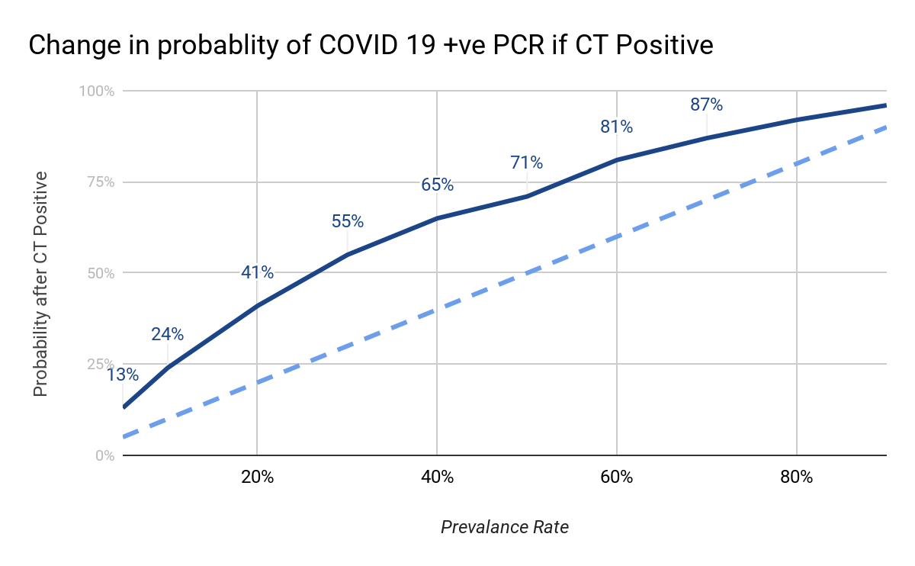
Is it worthwhile doing CT scans for COVID 19 ?
Gietema et al, prospective study all “symptomatic” patients visiting ED
CT and RT PCR done on arrival for all
Results :
  Sensitivity of CT = 89%
  Specificity of CT = 68%
  Prevalence = 43%
Positive LR = 2.8
  In symptomatic patients presenting to ED if a CT is positive then chances of finding +ve RT PCR increases by 15 - 20%
Negative LR = 0.16
  In symptomatic patients presenting to ED if a CT is negative then chances of finding -ve RT PCR increase by 30 - 45%
 | RT PCR +ve | RT PCR -ve | Total
CT +ve | 74 | 35 | 109
CT -ve | 9 | 75 | 84
Total | 83 | 110 | 193
Notes:
This is an interesting study done in Netherlands, where they prospectively did RT PCR and CT for symptomatic patients presenting in ED. The sensitivity is high at 89% but specificity is low at 68%. The positive likelihood ratio of 2.86 indicates that if such a patient comes to ED and a CT is done we basically improve the chances of finding a positive RT PCR by about 15 - 20%. Note that this change is true irrespective of the prevalence of the disease. Thus when the prevalence of the disease is 5% then doing a CT increases the chance of finding a positive COVID to about 13%. In other words doing CT as a screening test is possibly not helpful in a population of symptomatic patients presenting to ED.
The authors made an interesting conclusion : “The accuracy of chest CT in symptomatic ED patients is high, but used as a single diagnostic test, CT can not safely diagnose or exclude COVID-19. However, CT can be used as a quick tool to categorize patients into “probably positive” and “probably negative” cohorts.” Why did they use the last line - as they used mobile CT for screening patients in ED.

